Slide 1
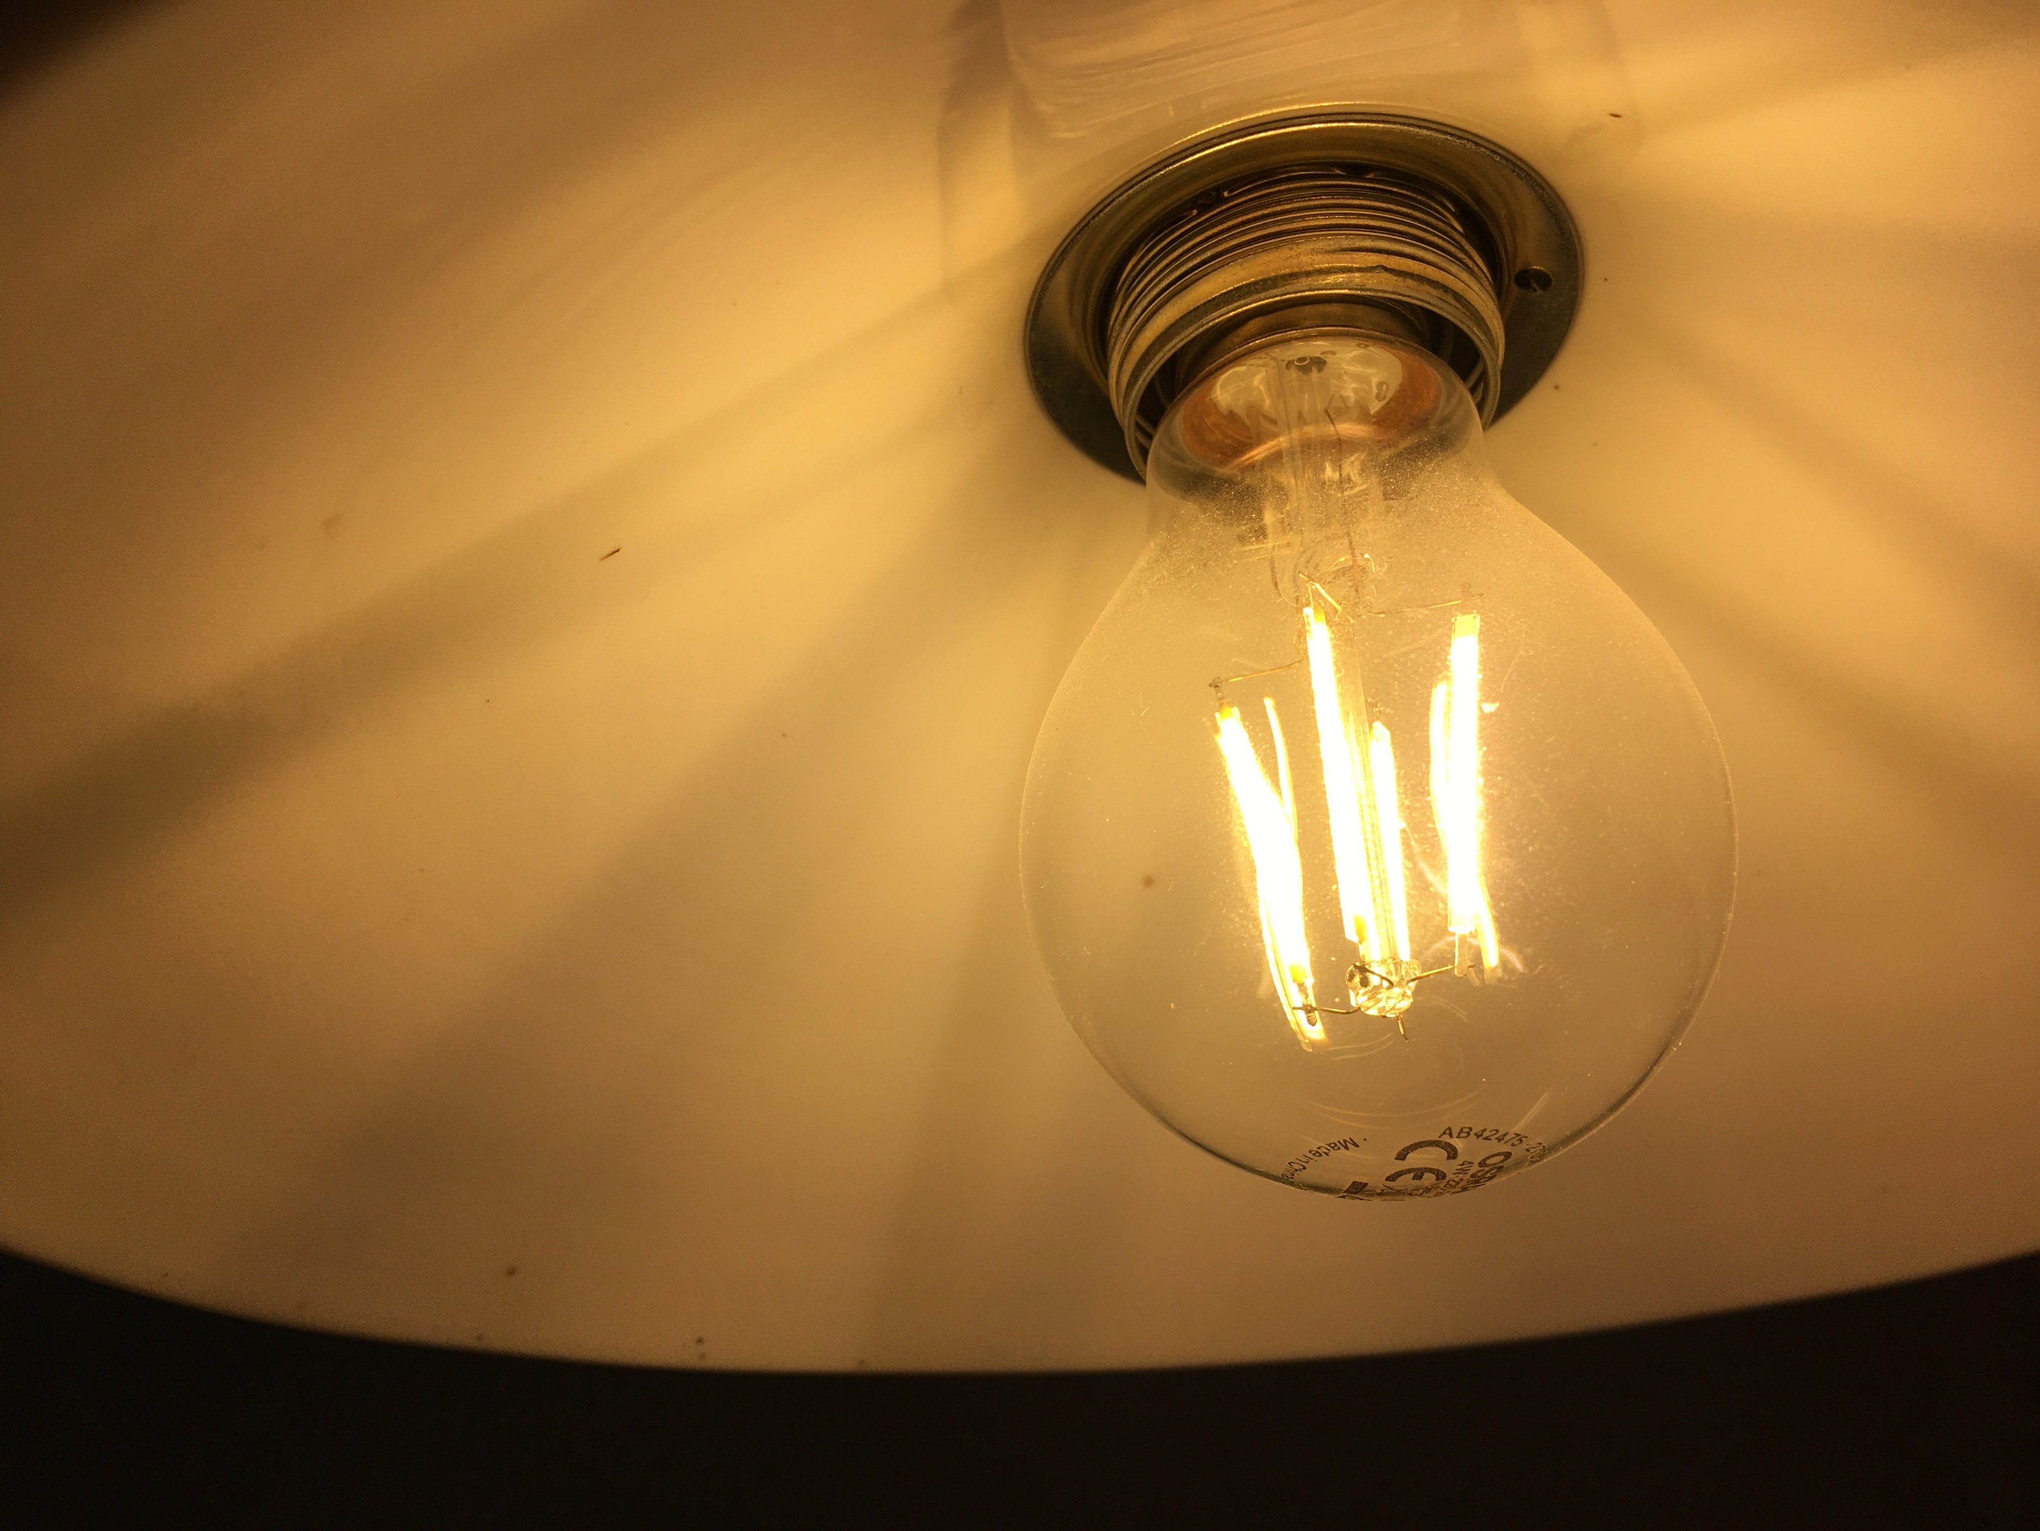
Energy Efficiency Watch 4 - The impact of narratives on effective policy implementation s Daniel Becker & Malte Gephart, Guidehouse 5 April 2022
This project has received funding from the European Union’s Horizon 2020 research and innovation programme under grant agreement No 847153.
Notes:
Webinar preparation
Store the Power Point Presentation that will be presented locally on your computer
Check the camera and light conditions as well as the audio quality before the webinar.
Familiarize with the webinar platform, especially with the functions for screen sharing and screen recording.
Screen sharing: 1. Start presentation mode in Power Point, 2. Share screen in Zoom selecting ‘Power Point Slide Show’.
Please advise your family members before the workshop to avoid using the internet connection during the webinar.
Turn of apps on your computer that utilize the internet connection.
Print out a participant list with names and organizations for taking notes during the welcome session. The list can be useful for namely referring to participants during the discussion with additional background information.
Moderator starts the webinar by sharing the application view of Power Point.
Contingency planning for connection issues
Dealing with light connection issues: Turn of the video feature for the moderator and turn of any other apps that might use the internet connection. Ask for a brief break and ask your family to stop using the internet connection if possible.
Dealing with strong connection issues: Announces that the session has to be canceled due to the connection issues and that there will be further notice via email. Also leave a message in the chat box.

Slide 2
Background: Energy Efficiency Watch 1-4 From policy analysis to the role of narratives
2007
Today
Why narratives?
Hardly any proven energy efficiency policies around when NEEAP process started
Initially, predominance of info campaigns
Many approaches still rather theoretical
Often doubted whether broad energy efficiency policies could address complex savings potentials
Impressive toolbox of energy efficiency policy instruments
Many of them are good practice
Decentral EU approach provides great variety
Yes we can: EU-27 has succeeded in developing good energy efficiency policies!
Enabling narrative: coherent, established story
Broad acceptance among stakeholders and broader society
Adoption of energy efficiency policy
Proper implementation
Which narratives can help with the choice for and implementation of good EE policies?
Notes:
Notes for presentation
Comparing the starting point in 2007 with the current situation allows for the conclusion that the process of defining and shaping policy instruments has been faster and more successful than expected
However, the comparison also shows that the implementation of these policy instruments is very unevenly distributed among EU MS and to slow for target achievement on EU level
Comparing the progress of EU MS on an overall level, many ups-and-downs in the level of ambition of energy policies were observed
Background
In 2007, when the National Energy Efficiency Action Plan (NEEAP) process started, hardly any proven energy efficiency (EE) policy instruments were in the implementation stage. Many approaches were still rather theoretical, and it was often doubted whether broad EE policies could address the complex savings potentials across the various sectors (prominent example: it was generally assumed that supplier obligations could only deliver for highly standardized potentials in the building sector, but practice showed that they also successfully tapped large and complex industrial potentials). A decade later, after the third set of NEEAPs had been prepared, an impressive tool box of EE policies had evolved. Many of the instruments can be characterized as ‘good practice’. It has been proven that through the NEEAPs member states succeeded in developing well designed EE policies. The decentral approach across the EU MS has positively contributed to the variety of approaches and provides a rich source for mutual learning. Nevertheless, even a well-designed instrument is bound to fail or remain far behind its potential when implementation is lagging behind or done in a half-hearted manner (stop-and-go, frequent changes, intransparency, high transaction cost etc.).

Slide 3
EU27: Key input factors for narrative development
Topic |  | Importance in the public debate (ranking) |  | Topics linked to energy efficiency (ranking) | Positively discussed | Negatively discussed |  | Actor group | Influence on politics (ranking) | Supportive of energy transition | Opinion not known | Opposed to energy transition
Jobs |  | 1 |  | 6 | 72 % | 28 % |  | Associations of large industry | 1 | 47 % | 13 % | 40 %
Industrial competitiveness |  | 2 |  | 2 | 63 % | 37 % |  | Trade Unions | 2 | 37 % | 40 % | 23 %
Modernisation / investments |  | 3 |  | 1 | 44 % | 56 % |  | Chambers of Commerce | 3 | 52 % | 28 % | 20 %
Housing / living costs |  | 4 |  | 3 |  |  |  | Tabloid press | 4
Air quality |  | 5 |  | 4 |  |  |  | Farmers organisations | 5
Independence from other countries |  | 6 |  | 5 |  |  |  | NGOs | 6
Rural development |  | 7 |  | 7 |  |  |  | Churches | 7

Slide 4
Key Narratives around EE
Participation and Transparency
Case 1: Communication, Dialogue and Participation
Economic Aspects
Case 3: Only talk about the real business case for energy efficiency
Connotation of Change
Case 6: Good to be a front-runner
Social Acceptance
Case 2: Independent and transparent data base
Case 4: The image of technologies
Case 7: Empowering Research and Innovation for Energy Efficiency
Case 8: Education, training and upskilling
Case 9: Communicate on price effects and social compensation
Case 10: Just transition
Case 5: Energy Efficiency as integral improvement of the production cycle

Slide 5
Overarching policy recommendations
The mechanisms
The “to-do’s”
Insufficient implementation → understanding why are things not happening?
Key role: perception & connotation of policy instruments / energy transition
Full picture impact factors
Communicative strategies
Participation of relevant target groups / stakeholders
Broader understanding of economic EE potential (beyond just saving)
Important links to other policy fields (e.g. education, research)
Comprehensive policy packages
Strategic planning of implementation
Break the predominance of the supply side
Foster evolvement of business

Slide 6
Key recommendations per cluster
Participation and Transparency
Transparent data → foundation for targets, policies and monitoring
Economic Aspects
Connotation of Change
Change → scepticism
Social Acceptance
Analyze target groups → what is really needed?
Dialogue and participation formats to
Policies to support evolving business cases & scaling
Energy/cost savings →overarching potential for modernizing production processes
Education, training and upskilling → cross sectoral policy packages (e.g. energy AND education).
Uncertainty about winners and losers → delay or obstruction of policies
Positive connotation of change (economic opps, transparent gains and losses)
Financial support AND image factors
Comprehensive policy packages (energy, research and education)
No ‘race for highest compensation’
Price effects (e.g. CO2-tax) → focus on communicating related price increase and level of compensation
ensure information flow
manage expectations
create buy-in
form alliances
use momentum of civil society
Expectation management on meaning and impact of a ‘just’ transition

Slide 7
Remarks on implications of Ukraine crisis
Potential of EE for energy security is significant, but not yet taken seriously
Energy security ranked low in expert survey and in stakeholder workshops
Discussions mostly dominated by supply side (‚this is the real stuff‘)
EE seen as the ‚little sister‘
Current gas dependence is high due to lack of integrated strategic planning (supply and demand)
To strengthen strategic energy planning, EE must get an appropriate role in it

Slide 8
THANK YOU
WWW.ENERGY-EFFICIENCY-WATCH.ORG
Daniel Becker & the Guidehouse Team
Daniel.Becker@guidehouse.com

